Slide 1

Comprehensive Design of Intelligent Systems

Slide 2

目录
CONTENTS
01
Introduction to Intelligent Systems
02
Key. Components of Intelligent Systems
03
Design Principles for Intelligent Systems
04
Smart Warehouse - Introduction to JD.com Asia No.1 Warehouse
05
Future Trends in Intelligent Systems
06
Conclusion and Recommendations

Slide 3


01
Introduction to Intelligent Systems

Slide 4



Definition and Scope
Definition Core
Evolutionary Path
Application Areas
Intelligent systems are advanced technologies that mimic human intelligence to perform tasks. They integrate machine learning, natural language processing, and computer vision to solve complex problems efficiently.
These systems are widely used in healthcare, finance, transportation, and manufacturing. They enhance decision-making, automate processes, and improve user experiences through personalized interactions.
The evolution of intelligent systems has progressed from rule-based systems to machine learning models and now to deep learning architectures. This progression has significantly increased their capabilities and adaptability.

Slide 5
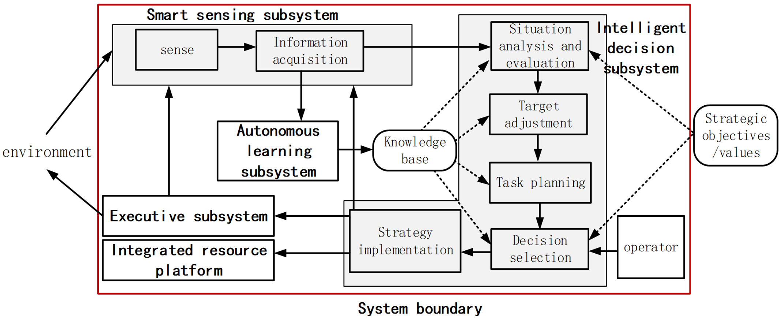
Definition and Scope

Slide 6
02
Key. Components of Intelligent Systems

Slide 7
Hardware Infrastructure
Processing Units
High-performance CPUs and GPUs are essential for processing large datasets and running complex algorithms. They ensure the system can handle intensive computational tasks efficiently.
Memory and Storage
Sufficient memory and storage are crucial for storing data and models. SSDs and cloud storage solutions provide fast access and scalability to meet the demands of intelligent systems.
Connectivity Options
Robust connectivity options like Wi-Fi, Ethernet, and 5G are necessary for seamless data transfer and real-time communication between system components.

Slide 8

Software Frameworks
01
Machine Learning Libraries
Libraries such as TensorFlow and PyTorch provide a wide range of tools and functions for building and training machine learning models. They simplify the development process and improve model performance.
02
Natural Language Processing Tools
NLP tools like spaCy and NLTK enable the system to understand and process human language. They are used for tasks such as text analysis, sentiment analysis, and language translation.
Computer Vision Modules
03
Computer vision modules like OpenCV allow the system to interpret and analyze visual information. They are used in applications such as object detection, facial recognition, and image classification.

Slide 9
Data Management
Data Collection
Data Storage and Retrieval
Data Preprocessing
Data is collected from various sources such as sensors, databases, and user interactions. It is essential to ensure data quality and relevance for effective system performance.
Data preprocessing involves cleaning, normalization, and transformation. This step is critical for preparing data to be used in training models and improving accuracy.
Efficient data storage and retrieval mechanisms are necessary for quick access to data. Techniques such as indexing and caching are used to optimize performance.

Slide 10
Smart Manufacturing Based on Industrial Internet
Smart manufacturing based on the Industrial Internet is an innovative manufacturing model. It deeply integrates traditional manufacturing with modern information technology by using cloud computing, the Internet of Things, big data analysis, artificial intelligence, and other technologies to realize the intelligence, automation, and networking of the manufacturing process. The following are some key features of smart manufacturing:
Digitalization: Through digital technology, various data in the manufacturing process are converted into digital information, facilitating collection, storage, and analysis.
Networking: Using IoT technology to achieve interconnection between equipment, machines, and systems, enabling production equipment to collaborate with each other and share information.
Intelligence: Applying artificial intelligence and machine learning algorithms to enable manufacturing systems to independently optimize production processes, predict and respond to problems in production.
Customization: Realizing personalized customization and small-batch production through flexible production lines and intelligent systems to meet customers' diverse needs.

Slide 11
Smart Manufacturing Based on Industrial Internet
5. Supply Chain Collaboration: Achieving information sharing and business collaboration among upstream and downstream of the supply chain through the industrial Internet platform to improve the response speed and efficiency of the supply chain.
6.Intelligent Analysis: Using big data analysis technology to conduct in-depth analysis of production data and provide a scientific basis for decision-making.
7. Cloud Services: Providing various services through cloud platforms, such as cloud design, cloud manufacturing, cloud services, etc., to reduce enterprise operating costs and improve resource utilization.
8. Security and Maintenance: Combining advanced security technologies and predictive maintenance to ensure the stable operation of production systems and data security.
9. Environmental Friendliness: Smart manufacturing focuses on energy management and environmental protection in the production process, and is committed to achieving green manufacturing and sustainable development.
10. Human-Machine Collaboration: In a smart manufacturing environment, humans and machines work together. Machines undertake repetitive and high-intensity work, while humans are responsible for creative and decision-making tasks.

Slide 12
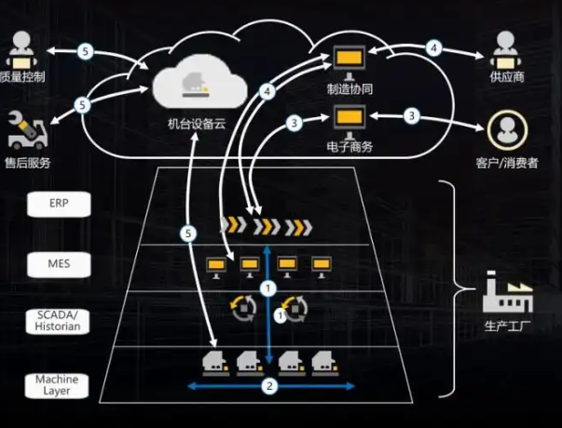
Industrial Internet Plus Intelligent Manufacturing Solutions

Slide 13
Applications of Smart Manufacturing in R&D, Planning, Production, and Quality
Intelligent design, intelligent planning, intelligent supply, intelligent production, intelligent quality, and intelligent cost management systems are key components of smart manufacturing. They together form a highly integrated solution to improve the efficiency, flexibility, and responsiveness of the manufacturing process. The following is a detailed introduction to these systems:
Intelligent Design Management
Intelligent design management systems (such as PLM, Product Lifecycle Management) use digital tools to support the entire process of products from concept to market. It includes:
Standardization work: Ensuring the consistency and reusability of standard parts, raw materials, etc. used in the design process.
Project management: Realizing the standardization of the R&D process through methods such as WBS (Work Breakdown Structure).
Data-driven design: Using data analysis to optimize design, reduce iterations, and accelerate product launch time.

Slide 14
Applications of Smart Manufacturing in R&D, Planning, Production, and Quality
Intelligent Planning Management
Intelligent planning systems (such as APS, Advanced Planning and Scheduling) optimize production planning and scheduling through advanced algorithms:
Multi-level application: From simple batch planning to complex Material Requirements Planning (MRP) and finite capacity scheduling.
Improving plan executability: Establishing scientific and reasonable plans by comprehensively considering various production factors through the system.
Dual-mode scheduling: Combining different scheduling algorithms, such as the earliest start algorithm , to adapt to different production needs.
Intelligent Supply Management
Intelligent supply management systems (such as WMS, Warehouse Management System) optimize inventory and logistics in the following ways:
Warehouse management: Refining to the level of storage locations and operations to improve warehouse operation efficiency.
Barcode and RFID technology: Enabling accurate tracking and management of goods.
Multi-level functional architecture: Realizing complex warehousing strategies and process automation based on an independent data platform.

Slide 15
Applications of Smart Manufacturing in R&D, Planning, Production, and Quality
Intelligent Production Management
The Manufacturing Execution System (MES) is the core of intelligent production management, which includes:
Production process management: Real-time monitoring of production progress to ensure the execution of production plans.
Process management: Optimizing production processes to improve production efficiency and product quality.
Material management: Precisely controlling the use and flow of materials to reduce waste.
Quality traceability: Recording production data to realize the whole-process traceability of product quality.
Intelligent Quality Management
Intelligent quality management systems ensure product quality in the following ways:
Quality inspection: Automated quality inspection processes to timely detect and solve quality problems.
Quality traceability: Recording detailed production data to facilitate the tracking and analysis of quality problems.
Quality assurance: Establishing and maintaining a quality management system to continuously improve product quality.

Slide 16
Applications of Smart Manufacturing in R&D, Planning, Production, and Quality
Intelligent Cost Management
Intelligent cost management systems achieve precise cost control by integrating systems such as MES, WMS, and ERP:
Cost accounting: Real-time tracking of production costs to optimize the cost structure.
Budget management: Integrating with financial systems to realize real-time monitoring and control of budgets.
Business intelligence: Using data analysis to provide decision support for cost optimization.

Slide 17
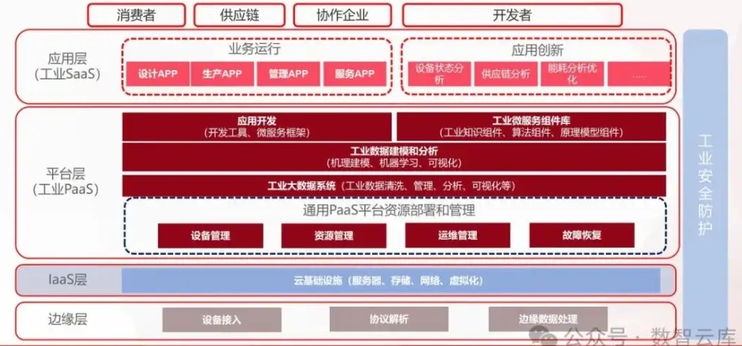
Industrial Internet Platform Architecture

Slide 18
Integration Relationship between Intelligent Production, Intelligent Supply Chain, and ERP
ERP (Enterprise Resource Planning), WMS (Warehouse Management System), and MES (Manufacturing Execution System) are three key information systems in modern manufacturing. Their integration is crucial for realizing smart manufacturing. The following is an introduction to the business, data, and application integration between them:
Business Integration
Sales and order management: Sales orders in the ERP system are directly transmitted to MES and WMS to start production and logistics activities.
Material requirements planning: The MRP (Material Requirements Planning) module in ERP generates material requirements, and this information is transmitted to MES for production planning and WMS for inventory management.
Inventory management: The actual inventory in WMS is fed back to the ERP system to ensure the accuracy and timely update of inventory data.
Production scheduling: MES formulates detailed production scheduling and operation instructions based on the production plans and material information in ERP.
Quality control: The quality management function in MES is integrated with ERP to ensure the consistency and traceability of quality data.

Slide 19
Integration Relationship between Intelligent Production, Intelligent Supply Chain, and ERP
Data Integration
Material master data: Material information in the ERP system (such as material number, description, BOM, etc.) is synchronized to MES and WMS.
Order data: Order information in the ERP system (such as customer orders, delivery dates, etc.) is synchronized to MES and WMS to guide production and delivery.
Inventory data: Inventory levels and inventory movement information in WMS are synchronized back to the ERP system to support inventory evaluation and financial reporting.
Production data: Data such as production progress, output, and downtime in MES are fed back to the ERP system for production analysis and cost calculation.
Quality data: Quality inspection data collected by MES is synchronized to the ERP system for quality reporting and improvement.

Slide 20
Integration Relationship between Intelligent Production, Intelligent Supply Chain, and ERP
Application Integration
User interface integration: Providing a unified user interface that allows users to switch seamlessly between ERP, WMS, and MES.
Workflow integration: Ensuring that the workflows between ERP, WMS, and MES are coordinated, such as order processing, material procurement, and production scheduling.
Report and analysis integration: Integrating data from the three systems to provide comprehensive business reports and analyses to support decision-making.
Exception management: Production exceptions and quality problems in MES can be timely fed back to the ERP system to trigger corresponding business processes.
System integration platform: Using middleware or integration platforms, such as OPEN API, Web services, etc., to realize data exchange and application integration between ERP, WMS, and MES.

Slide 21
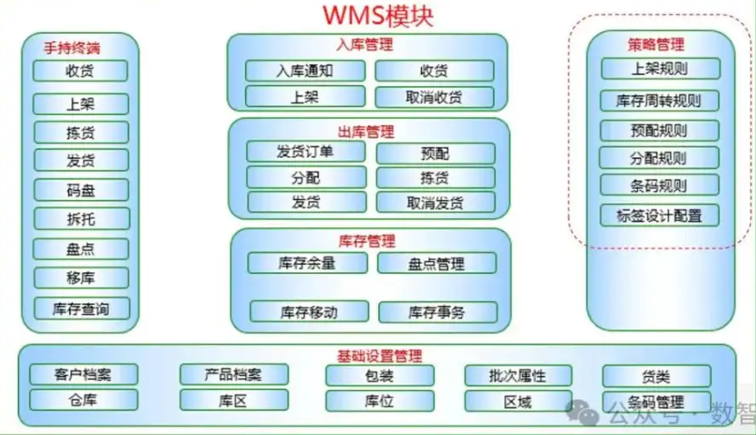
WMS Multi-level Functional Architecture Based on Independent Data Platform

Slide 22
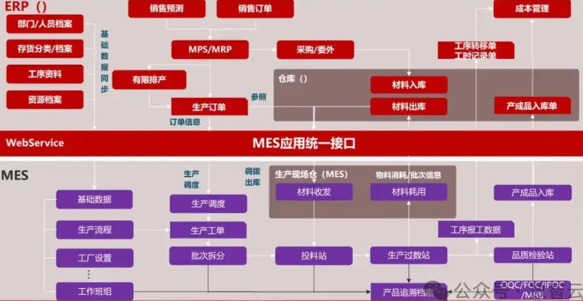
ERP and MES Integrated Control Process

Slide 23
03
Design Principles for Intelligent Systems

Slide 24

Scalability
Horizontal Scaling
Horizontal scaling involves adding more nodes to the system to handle increased load. This approach ensures the system can grow and adapt to changing demands.
Vertical Scaling
Vertical scaling involves upgrading existing hardware components. It is useful for improving performance but has limitations based on hardware capacity.
Load Balancing
Load balancing distributes incoming traffic across multiple servers to ensure optimal resource utilization and prevent system overload.

Slide 25

Reliability
01
02
03
Redundancy
Fault Tolerance
Regular Maintenance
Redundancy involves having backup components to ensure system availability in case of failures. This includes redundant hardware and data replication.
Fault tolerance mechanisms such as error detection and correction ensure the system continues to operate even if some components fail.
Regular maintenance and updates are essential to keep the system running smoothly. This includes software updates, hardware checks, and performance tuning.

Slide 26
Security
Data Encryption
Security Audits-
Access Control
Data encryption ensures data confidentiality and integrity. It protects sensitive information from unauthorized access during storage and transmission.
Access control mechanisms such as authentication and authorization ensure only authorized users can access the system. This includes user roles and permissions.
Regular security audits and vulnerability assessments help identify and mitigate potential security risks. They ensure the system complies with security standards.

Slide 27
04
Smart Warehouse - Introduction to JD.com Asia No.1 Warehouse

Slide 28
Overview of the Warehouse
JD.com Asia No.1 Warehouse is an intelligent warehousing center under JD.com Group, representing JD.com's innovation and technological strength in the logistics field.
As an important part of JD.com's logistics system, Asia No.1 Warehouse has improved warehousing efficiency and reduced operating costs by introducing advanced automated technologies and intelligent management systems, providing strong support for JD.com's rapid development.
The warehouse covers a vast area, with hundreds of thousands of square meters of modern warehousing space, equipped with advanced shelf systems, conveying systems and sorting systems.
JD.com Asia No.1 Warehouse is located in an important logistics hub city in China, with superior geographical location and convenient transportation.

Slide 29
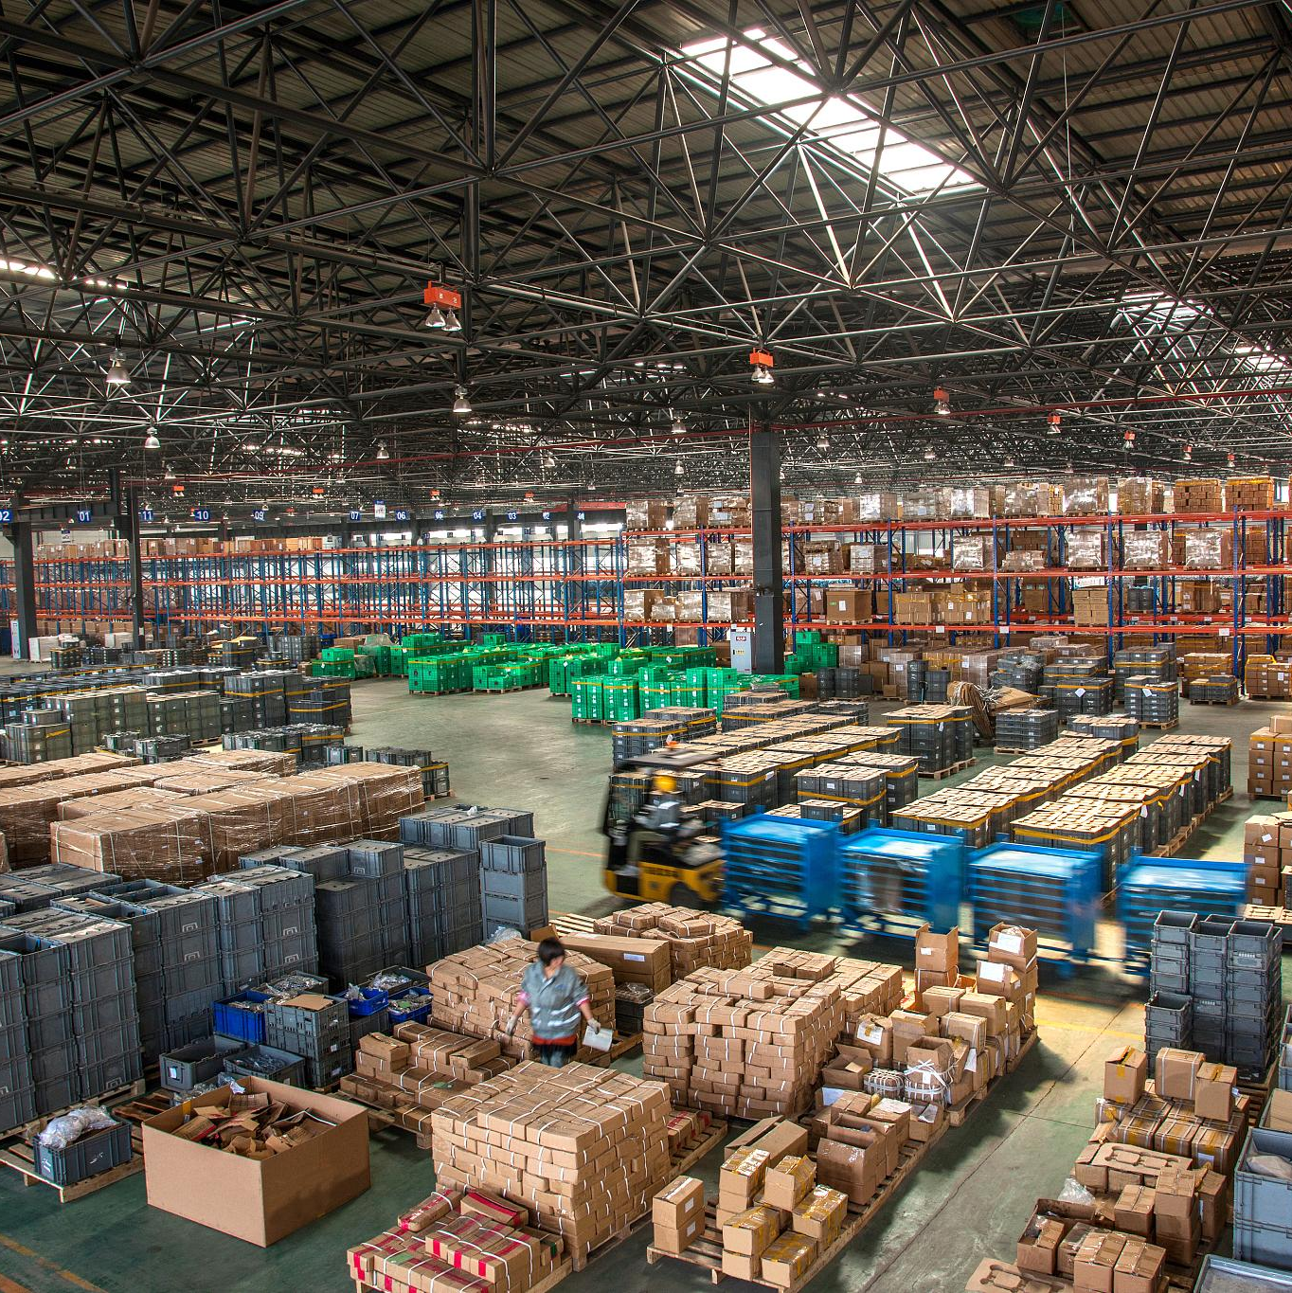
Main Business and Functional Positioning
JD.com Asia No.1 Warehouse is mainly responsible for the storage, management and distribution of JD.com's self-operated commodities, covering various types of goods such as home appliances, digital products, household items and daily necessities.
As a core link in JD.com's logistics system, Asia No.1 Warehouse realizes the rapid warehousing, storage, sorting and delivery of goods through highly automated warehousing equipment and intelligent management systems, ensuring the timely delivery of JD.com's orders and customers' satisfactory experience.

Slide 30
Automated Storage and Retrieval System
High-Density Storage
Real-Time Monitoring
Rapid Retrieval
The use of three-dimensional shelves and automated stackers enables high-density storage of goods, improving the utilization rate of warehouse space.
Through an advanced warehouse management system, the rapid retrieval and positioning of goods are realized, improving picking efficiency.
Real-time monitoring of the storage status of goods ensures the safety and accurate delivery of goods.

Slide 31
Robot Handling and Sorting Technology
Robot Handling
Advanced robot technology is adopted to realize automatic handling and transfer of goods, reducing manual labor intensity.
Intelligent Sorting
Through image recognition and artificial intelligence technology, goods are automatically identified and classified, improving sorting speed and accuracy.
Flexible Production
Robot handling and sorting technology can flexibly handle goods of different specifications and shapes, realizing flexible production.

Slide 32
Unmanned Vehicle Delivery
01
Unmanned Vehicles
Advanced automatic driving technology is adopted to realize automatic navigation and delivery of unmanned vehicles.
02
Efficient Delivery
The delivery efficiency and accuracy of unmanned vehicles are improved by optimizing delivery routes and algorithms.
Safety and Reliability
03
Unmanned vehicles are equipped with a variety of sensors and safety measures to ensure safety and reliability during delivery.

Slide 33
Introduction to Systems such as WMS/TMS/OMS
WMS (Warehouse Management System)
Responsible for functions such as inventory management, location management and operation management in the warehouse, realizing the automation and intelligence of warehouse operations
TMS (Transportation Management System)
Comprehensively manages orders, vehicles, routes, etc. in the transportation process, optimizes transportation plans and improves transportation efficiency
OMS (Order Management System)
Connects with customer orders, performs order processing, tracking, settlement and other operations, ensuring the accuracy and timeliness of order information.

Slide 34
Data Collection, Transmission and Processing Process
Data Collection
Through RFID, bar code and other identification technologies, goods are quickly and accurately identified and positioned.
Data Transmission
Using wireless network, Internet of Things and other technologies, the collected data is transmitted to the information management system in real time.
Data Processing
The system processes and analyzes the received data, generates various reports and statistical data, and provides support for decision-making.

Slide 35
Real-Time Monitoring and Scheduling Optimization
Real-Time Monitoring
Through the information management system, real-time monitoring of the status of goods in the warehouse, the operation status of equipment and the work of personnel is carried out.
Scheduling Optimization
According to real-time monitoring data, dynamic scheduling and optimization of warehouse operations are carried out to improve the efficiency and accuracy of warehouse operations. For example, according to the storage status of goods and the outbound plan, the optimal picking path and loading plan are automatically generated.

Slide 36
05
Future Trends in Intelligent Systems

Slide 37
Advancements in AI and Machine Learning
Deep Learning Innovations
Reinforcement Learning
Transfer Learning
Deep learning continues to advance with new architectures and algorithms. This will enable more accurate and efficient models for various applications.
Transfer learning allows models trained on one task to be adapted to another. This will reduce training time and improve model performance in new domains.
Reinforcement learning will play a significant role in developing autonomous systems. It enables systems to learn from their environment and make optimal decisions.

Slide 38
Integration with IoT
Smart Cities
The integration of intelligent systems with IoT will lead to the development of smart cities. These cities will have optimized infrastructure, efficient resource management, and improved quality of life.
Industrial IoT
In the industrial sector, IoT-enabled intelligent systems will enhance automation, predictive maintenance, and supply chain management. This will increase productivity and reduce costs.
Connected Devices
The proliferation of connected devices will provide more data for intelligent systems. This will enable more personalized and context-aware applications.

Slide 39
Ethical and Social Considerations
01
Bias and Fairness
Addressing bias in intelligent systems is crucial to ensure fairness and avoid discrimination. Techniques such as data debiasing and model fairness evaluation will become more important.
02
Privacy Concerns
As intelligent systems collect and process more data, privacy concerns will increase. Strong privacy regulations and data protection measures will be necessary.
Human-AI Collaboration
03
The future will focus on seamless human-AI collaboration. This will involve designing systems that augment human capabilities and ensure user trust.

Slide 40
06
Conclusion and Recommendations

Slide 41
Summary of Key Points
Comprehensive Overview
This presentation has provided a comprehensive overview of intelligent systems, including their components, design principles, and a case study. It has highlighted the importance of these systems in various applications.
Future Outlook
The future of intelligent systems looks promising with advancements in AI, integration with IoT, and ethical considerations. These systems will continue to transform industries and improve our lives.
Continuous Improvement
Continuous improvement and adaptation are essential for intelligent systems. This involves staying updated with technological advancements and addressing emerging challenges.

Slide 42

Recommendations for Implementation
Focus on Scalability and Reliability
When implementing intelligent systems, focus on scalability and reliability to ensure they can handle growing demands and operate efficiently.
Emphasize Data Quality
Prioritize Security
Emphasize data quality and preprocessing to improve model accuracy and performance. This will lead to more effective and reliable systems.
Prioritize security to protect data and ensure user trust. Implement robust encryption, access control, and regular security audits.

Slide 43
Future Research Directions
01
02
03
Interdisciplinary Research
User-Centered Design
Long-Term Impact Studies
Encourage interdisciplinary research to combine insights from different fields. This will lead to more innovative and comprehensive solutions.
Adopt a user-centered design approach to ensure systems meet user needs and are easy to use. This will improve user satisfaction and adoption.
Conduct long-term impact studies to understand the effects of intelligent systems on society. This will help in making informed decisions and addressing potential challenges.

Slide 44
THANK YOU

